Slide 1
Robust Ear Detection on 2D images using Deep Learning
Li Sun
29th Aug 2016

Slide 2
Flow Chart
Probability of ear
Image
Region of Interest (Ear Proposal boxes)
Deep learning
Ear box location
3 methods used
Selective search (SS)
Edge boxes Detector (ED)
Binarized normed gradients (BING)
Fast Region-based Convolutional Neural Network (fast R-CNN)

Slide 3
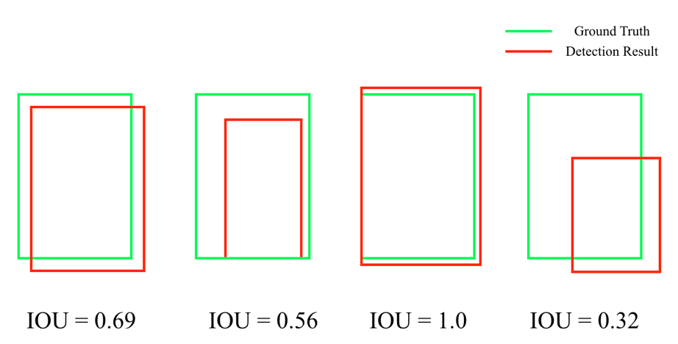
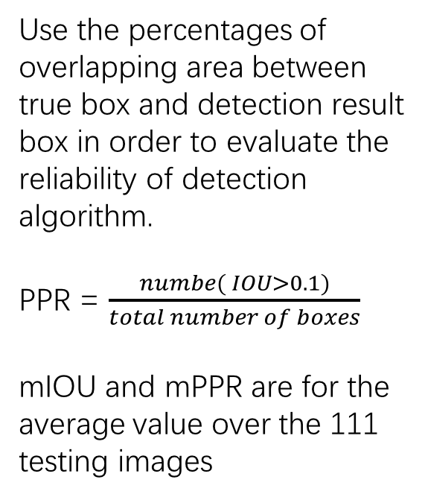
Intersection of Unit (IOU) & Potential Proposal Ratio (PPR)
Use the percentages of overlapping area between true box and detection result box in order to evaluate the reliability of detection algorithm.
PPR = $\frac{numbe( IOU>0.1)}{total number of boxes}$
mIOU and mPPR are for the average value over the 111 testing images

Slide 4
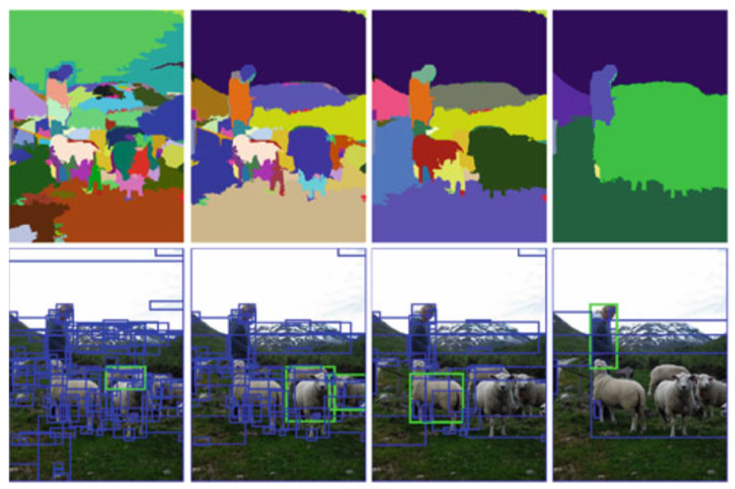
(1) Selective Search (SS)
It assume that objects in an image are hierarchical.
Based on image segmentation method with different scales, SS can generates different size of region of interest (object proposals).
Require more times (2.5 seconds for around 200 proposal boxes)
The mPPR for all the proposal boxes is below 0.1, which indicates this method is not very suitable.

Slide 5
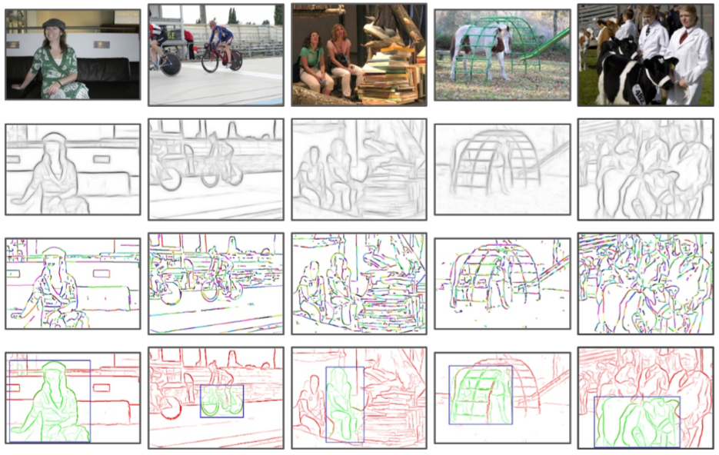
(2)Edge Boxes Detector(ED)
The amount of contours wholly enclosed in a bounding box indicate the possibility of box containing objects
Based on image edge informations
Require less times (0.5 seconds for around 500 proposal boxes)
The mPPR for all the proposal boxes is more than 0.6, which indicates this method is very good.

Slide 6
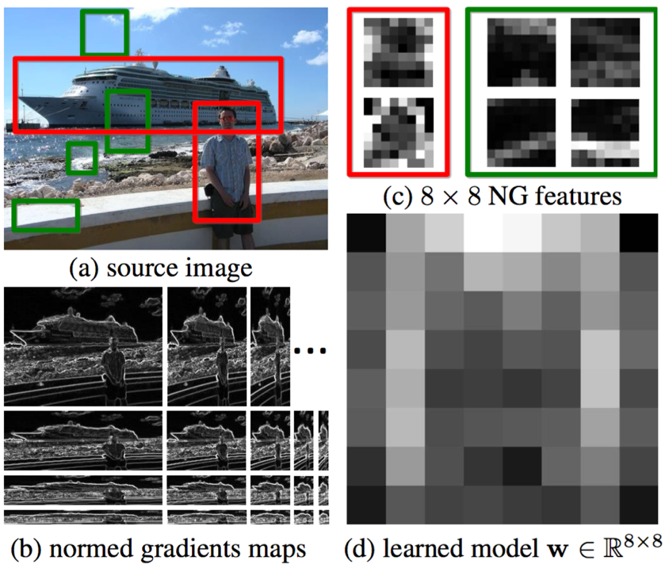
(3) Binarized Normed Gradients (BING)
If stand- alone things have well-defined closed boundaries and centres then it is highly possible to be an object.
Also based on edge information, but wrapped into a 8*8 gradients features.
Require less times (0.5 seconds for exactly 400 proposal boxes)
The mPPR for all the proposal boxes is between 0.1 and 0.2, which indicates this method is only better than SS.

Slide 7
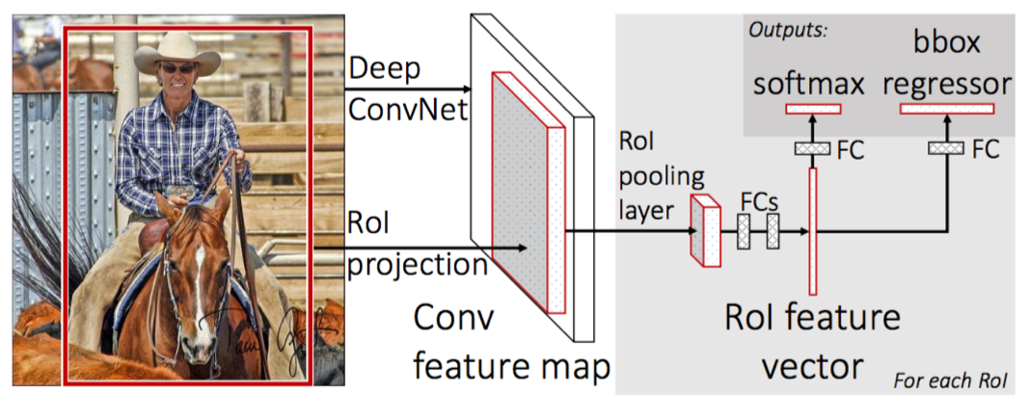
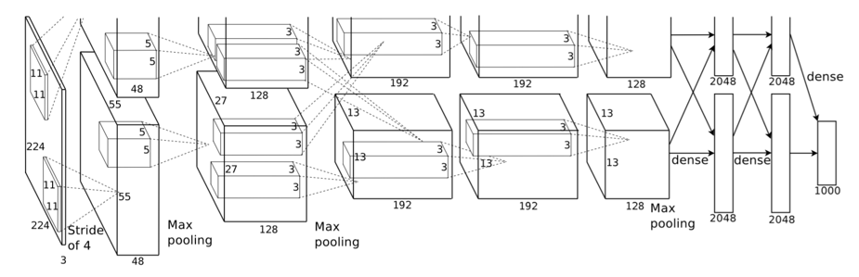
Deep Learning (fast R-CNN)
This fast R-CNN method is proposed by Ross Girshick in 2015 based on the structure of CNN by Hinton in 2012.
It improved the accuracy on PASCAL VOC object detection challenge by 30% which no one has ever done before.
It shows great power for the use of CNN towards object (in this case ear) detection problem.

Slide 8
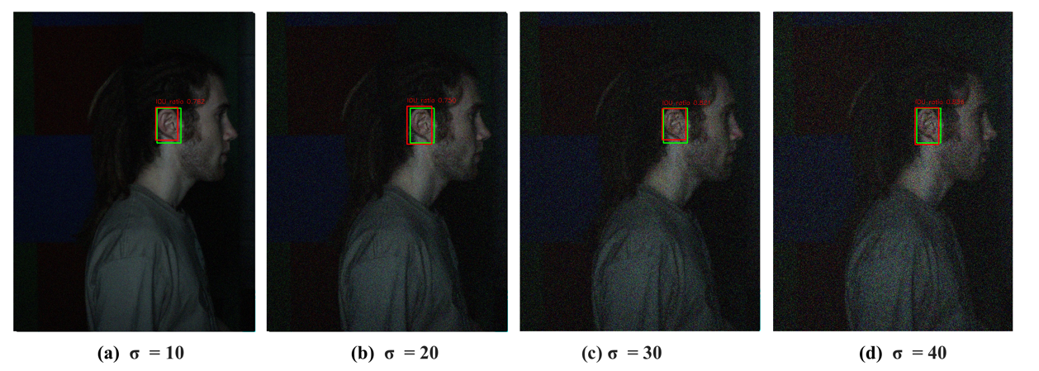
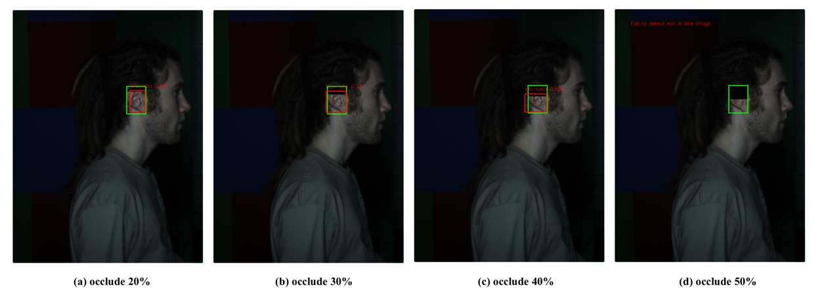
Evaluation
Detection Accuracy was evaluated under two parameters,
Gaussian Noise
Partial Occlusion

Slide 9
Results
Results show rank-1 100% detection accuracy without any noise and occlusion.
As expected, detection accuracy drops with the increase of both noise and occlusion.
ED was the best method for this project.

Slide 10
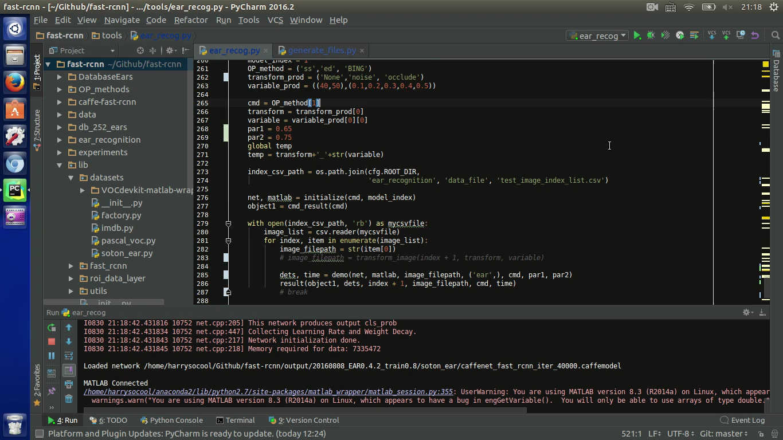
The whole project can be found on Github https://github.com/harrysocool/ear_recognition (exclude the database)
The screencast of algorithm on testing database images can be found below:

Slide 11
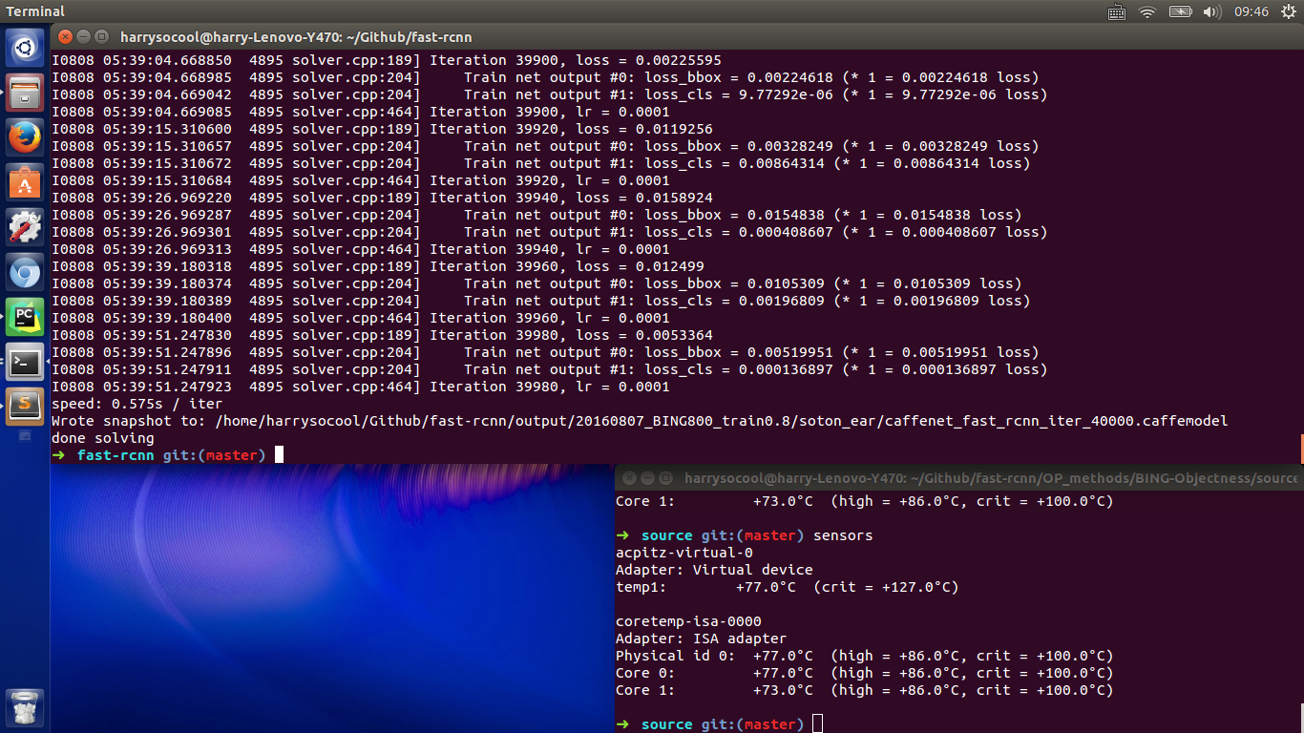
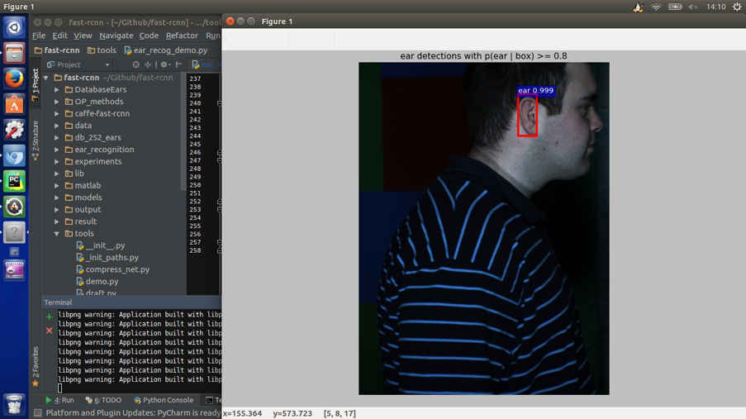
Screenshots for the algorithms
Screenshot after training fast R-CNN Screenshot while performing detection

